Slide 1



Deep Learning Design Patterns with Tensorflow 2.0
Computer Vision Workshop - Alternative Connectivity Patterns Version: Feb 2020
Repo: github.com/GoogleCloudPlatform/keras-idiomatic-programmer
twitter.com/andrewferlitsch

Slide 2
Alternative Connectivity Patterns
Overview
We will cover in this section alternative connectivity patterns beyond the sequential flow as in VGG, residual blocks as in ResNet, et. al, and parallel convolutions as in ResNext, etc.
We will cover the following:
DenseNet - introduced concept of feature reuse.
Xception - introduced a new architectural layout and new factorizations.
SE-Net - introduced the concept of feature excitation.

Slide 3
DenseNet
DenseNet introduced the concept of a Densely Connected Convolutional Network. The corresponding paper won CVPR 2017 (Best Paper Award).
It is based on the principal, that the output of each residual block layer is connected to the input of every subsequent residual block layer. This extends the concept of identity links.
In a dense block, the input to the residual block is concatenated to the output of the residual block. This change introduced the concept of feature (map) reuse.

Slide 4
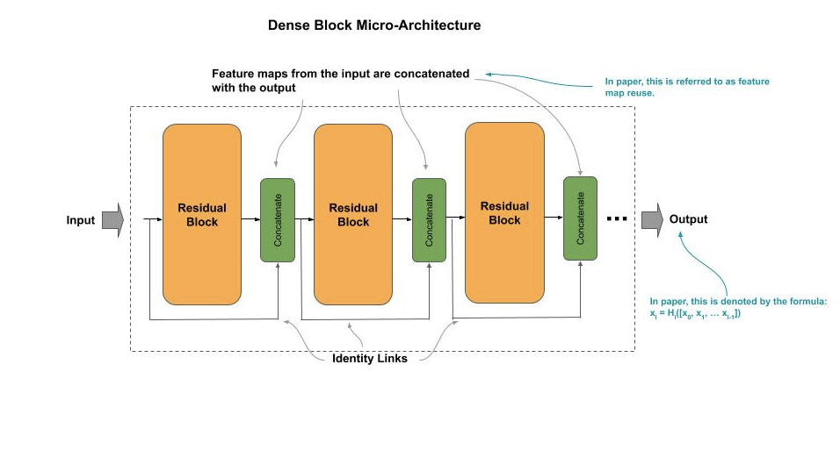
DenseNet
The replacing of the matrix addition with a concatenation has the advantages of:
Further alleviating the vanishing gradient problem over deeper layers.
Further reducing the computational complexity (parameters) with narrower feature maps.
With concatenation, the distance between the output (classifier) and the feature maps is shorter which reduces the vanishing gradient problem, allowing for deeper networks for higher accuracy.

Slide 5
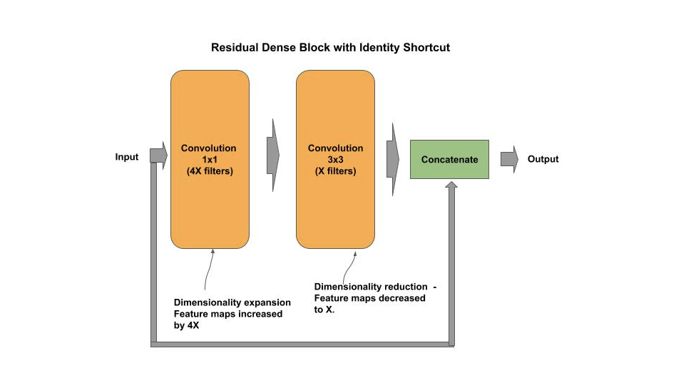
DenseNet Block
The residual block in DenseNet uses the B(1, 3) pattern of a 1x1 convolution followed by a 3x3 convolution, but where the 1x1 convolution is a linear projection instead of a bottleneck. That is, the 1x1 expands the number of output feature maps (filters) by an expansion factor of 4. The 3x3 then performs a dimensionality reduction restoring the number of output feature maps.
The reuse of feature maps has representational equivalence with the former operation of a matrix addition, but with more narrow layers. With the narrower layers, the overall number of parameters to train is reduced.

Slide 6
DenseNet Block
DenseNet also adopted the modern convention of using a pre-activation batch normalization (BN-RE-Conv). Below is an example of a densenet residual block:
# Remember input tensor into residual block shortcut = x # BN-RE-Conv pre-activation form of convolutions # Dimensionality expansion, expand filters by 4 (DenseNet-B) x = BatchNormalization()(x) x = ReLU()(x) x = Conv2D(4 * n_filters, (1, 1), strides=(1, 1))(x) # Bottleneck convolution # 3x3 convolution with padding=same to preserve same shape of feature maps x = BatchNormalization()(x) x = ReLU()(x) x = Conv2D(n_filters, (3, 3), strides=(1, 1), padding='same')(x) # Concatenate the input (identity) with the output of the residual block # Concatenation (vs. merging) provides Feature Reuse between layers x = Concatenate()([shortcut, x]) return x

Slide 7
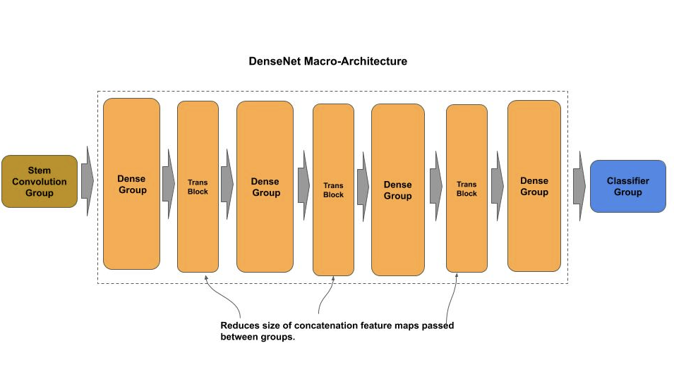
DenseNet Architecture
To further reduce computational complexity, a transition block is inserted between each dense block. The transition block is a strided convolution (feature pooling) used to reduce the overall size of the concatenated feature maps (feature reuse) as they move from one dense group to the next.

Slide 8
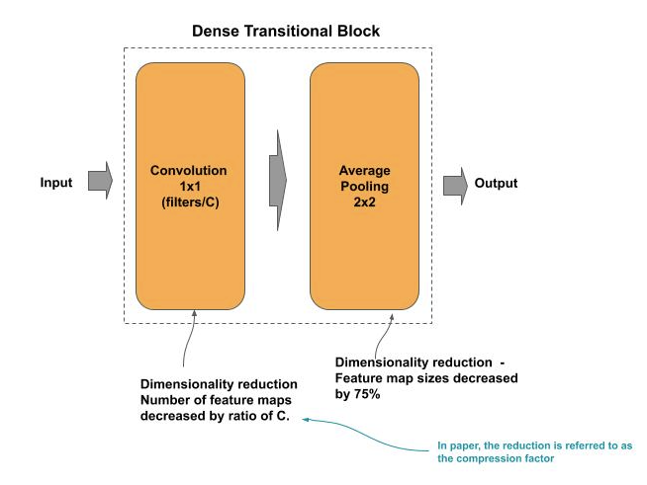
DenseNet Transition Block
The transition block consists of a:
A 1x1 bottleneck convolution which reduces the number of output feature maps (channels) by a compression factor C.
Followed by a strided average pooling that then reduces the size of each feature map by 75%.

Slide 9
DenseNet Transition Block
The transition block consists of a:
A 1x1 bottleneck convolution which reduces the number of output feature maps (channels) by a compression factor C.
Followed by a strided average pooling that then reduces the size of each feature map by 75%.
# Reduce (compression) the number of feature maps (DenseNet-C) nb_filters = int( int(x.shape[3]) * reduce_by ) # Bottleneck convolution x = layers.Conv2D(nb_filters, (1, 1), strides=(1, 1))(x) x = layers.BatchNormalization()(x) x = layers.ReLU()(x) # Use mean value (average) instead of max value sampling when # pooling - reduce by 75% x = layers.AveragePooling2D((2, 2), strides=(2, 2))(x) return x

Slide 10
DenseNet Group
Below is an example of a densenet group, where:
number of dense residual blocks is specified by the parameter n_blocks
number of output filters by n_filters and the compression factor specified by compression.
def group(x, n_blocks, n_filters, compression=None): """ Construct a Dense Group x : input to the group n_blocks : number of residual blocks in dense block n_filters : number of filters in convolution layer in residual block compression : amount to reduce feature maps by """ # Construct a group of densely connected residual blocks for _ in range(n_blocks): x = dense_block(x, n_filters) # Construct interceding transition block if compression is not None: x = trans_block(x, reduction) return x
For the last group where there is no transition block, is indicated by the parameter compression set to None.

Slide 11
Xception
The Xception (Extreme Inception) architecture was introduced by Francois Chollet/Google (creator of Keras) in 2017 as a proposed further improvement over the Inception v3 architecture. These two major changes were:
Reorganized the Inception architecture of the concept of having three inception-style residual groups (A, B and C) into an entry, middle and exit flow, where the stem group is part of the entry, the classifier is part of the exit, and reduced the structural complexity of the inception-style residual blocks.
The factorization of a convolution into a spatial separable convolution in an inception v3 block is replaced with a depthwise separable convolution.

Slide 12
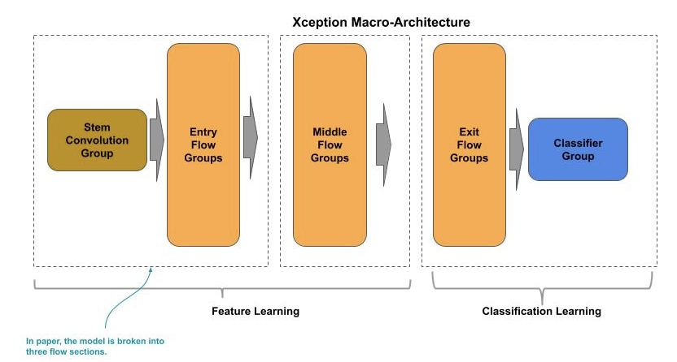
Xception Architecture

Slide 13
Xception Architecture
A skeleton implementation of the Xception architecture. The code is partitioned into an entry flow, middle flow and exit flow section. The entry flow is further sub-partitioned into a stem and body, and the exit flow is further sub-partitioned into a body and classifier.
def entryFlow(inputs): def stem(inputs): # … REMOVED for brevity return x # Create the stem to the neural network x = stem(inputs) # Create three residual blocks using linear projection for n_filters in [128, 256, 728]: x = projection_block(x, n_filters) return x
def middleFlow(x): # Create 8 residual blocks for _ in range(8): x = residual_block(x, 728) return x def exitFlow(x, n_classes): def classifier(x, n_classes): # … REMOVED for brevity return x # … REMOVED for brevity # Create classifier section x = classifier(x, n_classes) return x

Slide 14
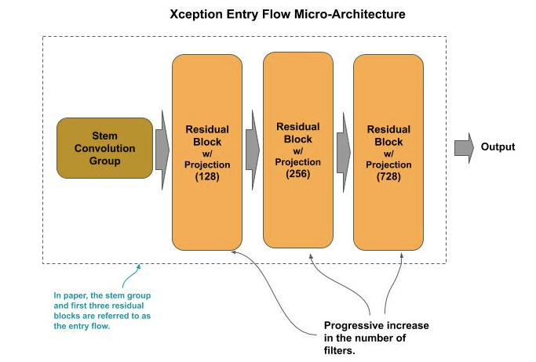
Xception Entry Flow
The entry flow component consists of the stem convolutional group, followed by three xception entry flow style residual blocks, successively outputting 128, 256 and 728 feature maps.

Slide 15
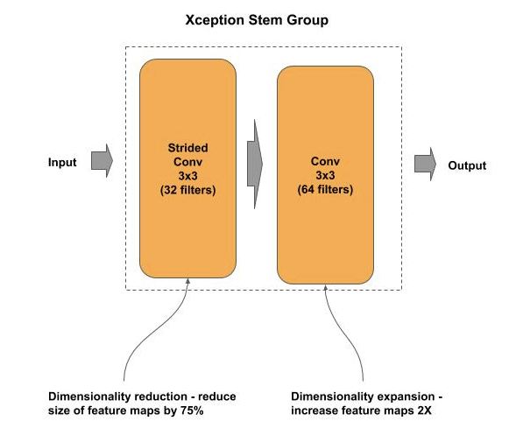
Xception Entry Flow - Stem
The stem consists of two 3x3 convolutions, where the first 3x3 convolution does feature pooling (strided) with 32 filters and the second 3x3 convolution does a dimensionality expansion by increasing the number of feature maps to 64.

Slide 16
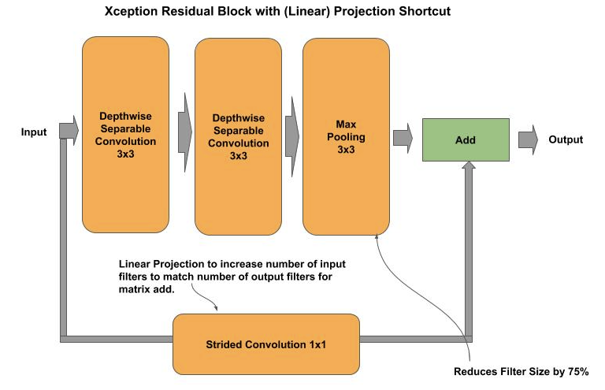
Xception Entry Flow - Residual Block
The entry flow style of residual blocks use a B(3, 3) residual block followed by a max pooling and 1x1 linear projection on the identify link.
The 3x3 convolutions are depth wise separable convolutions (SeparableConv2D).
The max pooling uses a 3x3 pooling size, thus outputting the maximum value from a 9 pixel window (vs 4 pixel for 2x2).

Slide 17
Xception Entry Flow - Residual Block
def projection_block(x, n_filters): shortcut = x # Strided convolution to double number of filters in identity link to # match output of residual block for the add operation (projection shortcut) shortcut = Conv2D(n_filters, (1, 1), strides=(2, 2), padding='same')(shortcut) shortcut = BatchNormalization()(shortcut) # First Depthwise Separable Convolution x = SeparableConv2D(n_filters, (3, 3), padding='same')(x) x = BatchNormalization()(x) x = ReLU()(x) # Second depthwise Separable Convolution x = SeparableConv2D(n_filters, (3, 3), padding='same')(x) x = BatchNormalization()(x) x = ReLU()(x) # Create pooled feature maps, reduce size by 75% x = MaxPooling2D((3, 3), strides=(2, 2), padding='same')(x) # Add the projection shortcut to the output of the block x = Add()([x, shortcut]) return x

Slide 18
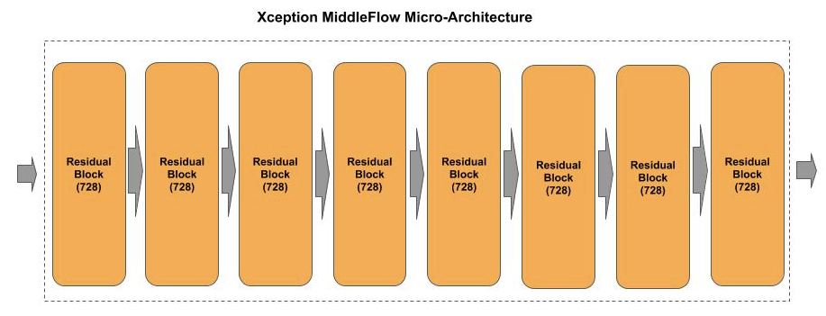
Xception Middle Flow
The middle flow consists of eight middle flow style residual blocks, each outputting 728 feature maps.

Slide 19
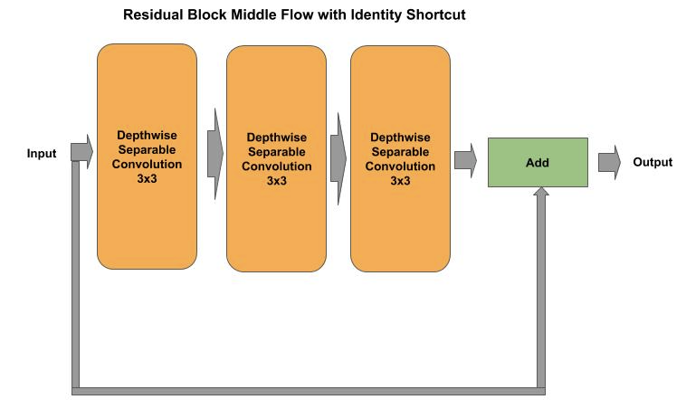
Xception Middle Flow - Residual Block
The middle flow style residual block uses a B(3, 3, 3) residual block. The 3x3 convolutions are depth wise separable convolutions (SeparableConv2D).

Slide 20
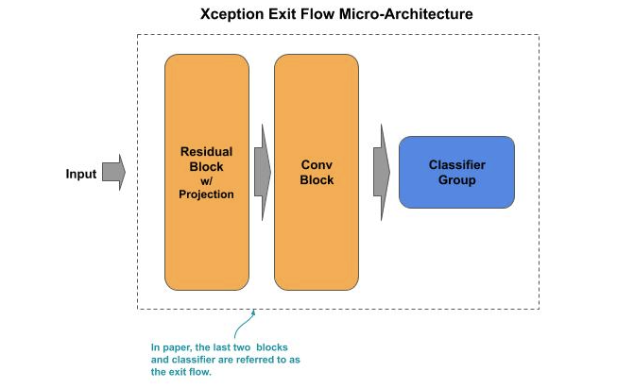
Xception Exit Flow
The exit flow consists of a:
single exit flow style residual block,
convolutional (non-residual) block
classifier.

Slide 21
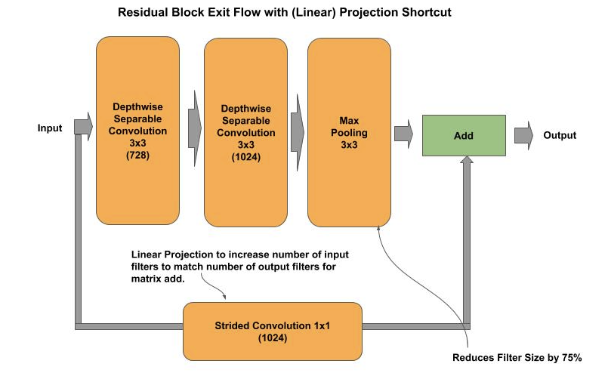
Xception Exit Flow - Residual Block
The single exit flow style residual block is a B(3,3) with the two convolutions outputting 728 and 1024 feature maps respectively, followed by a max pooling with a pooling size of 3x3, and a 1x1 linear projection for the identity link.
Note how the exit flow residual block structural is identical to the entry flow, except the exit flow style does a dimensionality expansion with the block, going from 728 to 1024 feature maps, while the entry flow does not do any dimensionality expansion.

Slide 22
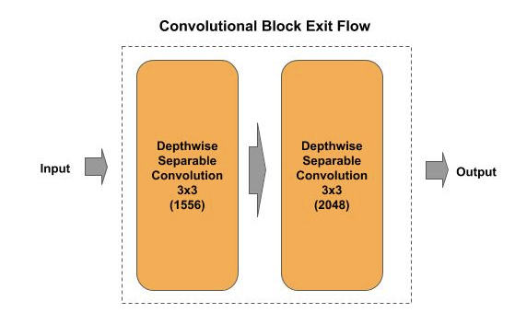
Xception Exit Flow
The convolutional block following the residual block consists of two 3x3 depth wise separable convolutions, each doing a dimensionality expansion increasing the number of feature maps to 1156 and 2048, respectively.

Slide 23
Xception - Depthwise Separable Convolutions
A depthwise separable convolution is used where a convolution cannot be factored into a spatial separable convolution without representational loss.
A depthwise spatial convolution factors a 2D kernel into two 2D kernels, where the:
first is a depthwise convolution and the
second is a pointwise convolution.

Slide 24
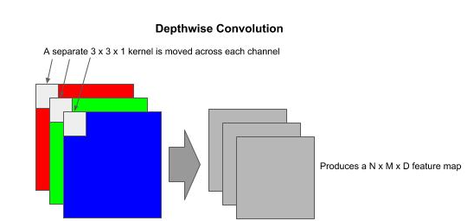
Xception - Depthwise Separable Convolutions
Depthwise Convolution
In a depthwise convolution the kernel is split into single H x W x 1 kernels, one per channel, and where each kernel operates on a single channel instead across all channels.
In the RGB example using a 3x3 kernel, a depthwise convolution would be three 3x3x1 kernels. While the number of multiply operations as the kernel is moved is the same as the normal convolution (e.g., 27 for 3x3 on three channels), the output is a D depth feature map instead of a 2D (depth=1) feature map.

Slide 25
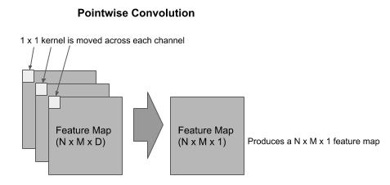
Xception - Depthwise Separable Convolutions
Pointwise Convolution
The output from a depthwise convolution is passed as the input to a pointwise convolution, which forms a depthwise separable convolution.
The pointwise convolution is used to combine the outputs of the depthwise convolution and expand the number of feature maps to match the specified number of filters (feature maps).
In the pointwise convolution we use 1x1xD kernels, one for each output. As in the early example, of our output is 256 filters (feature maps), we will use 256 1x1xD kernels.

Slide 26
Squeeze - Excitation Network (SE-Net)
SENet (Chinese Academy of Science, et. al.) was the winner of the 2017 ILSVRC competition for ImageNet and introduced the concept of adding a squeeze-excitation (SE) block inside a residual block between the convolution layer(s) output and the matrix add operation with the identity link.
The author’s referred to this as a novel architectural unit that allows the network to perform feature recalibration. Some of the benefits stated by their ablation study included:
Can be added to existing SOTA architectures, such as ResNet, ResNeXt and Inception.
Adds a minimal increase in parameters while achieving higher accuracy results.

Slide 27
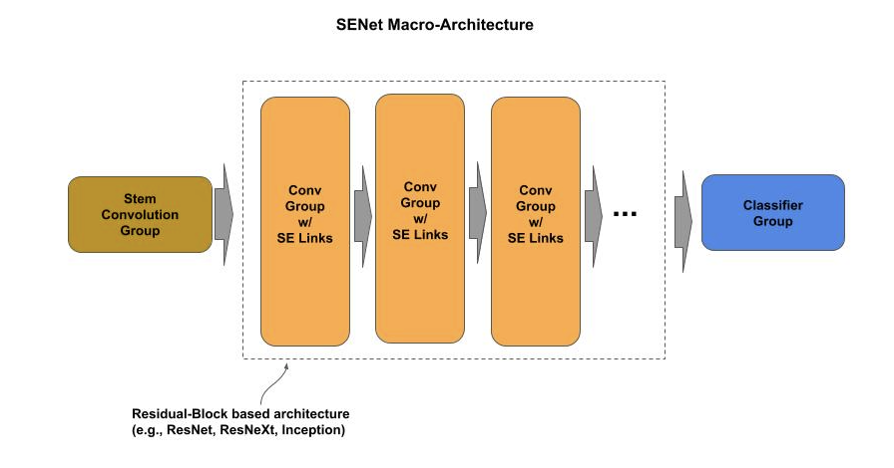
SENet - Architecture

Slide 28
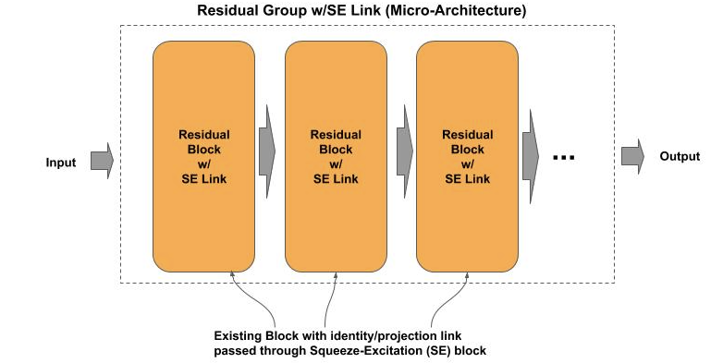
SENet - Micro-Architecture

Slide 29
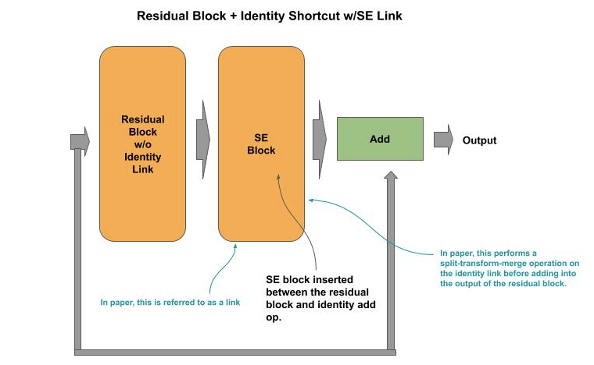
SENet - Residual Block
The SE Link is inserted into a residual block, where the SE Link is inserted between the convolution layer(s) output and the matrix add operation.

Slide 30
SENet - Residual Block
Below is an example implementation of adding a SE link to a ResNet residual block. At the end of the block, a call to squeeze_excite_block() is inserted between the output from the B(3,3) output and the matrix add operation (Add()).
def identity_block(x, n_filters, ratio=16): shortcut = x ## Construct the 1x1, 3x3, 1x1 residual block (fig 3c) # Dimensionality reduction x = Conv2D(n_filters, (1, 1), strides=(1, 1))(x) x = BatchNormalization()(x) x = ReLU()(x) # REMOVED for brevity ... # Pass the output through the squeeze and excitation block x = squeeze_excite_block(x, ratio) # Add the identity link (input) to the output of the residual block x = Add()([shortcut, x]) x = ReLU()(x) return x
The parameter ratio is the amount (ratio) of dimensionality reduction on the squeeze operation on the input prior to the subsequent dimensionality restoration by the excitation operation.

Slide 31
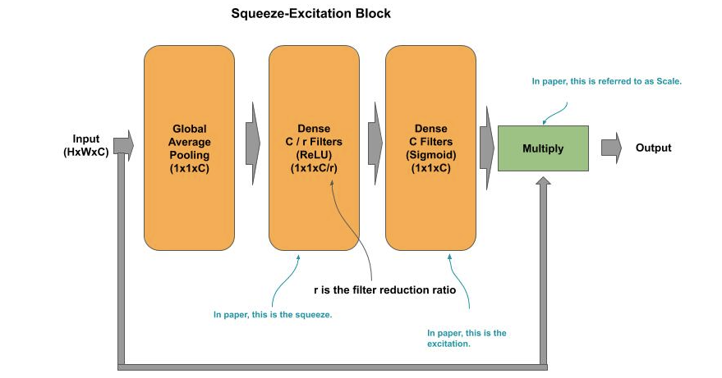
SENet - SE Link
The link consists of three layers. The first two layers performs the squeeze operation. A global average pooling is used to reduce each input feature map (channel) to a 1x1, outputting a 1D vector of size C (channels). The dense layer then further reduces the output by the reduction ratio r.
The squeezed output is passed to the third layer which performs the excitation by restoring back to the 1D vector of size C.
The final step is a scale operation that consists of an identity link from the input, where the 1x1xC vector from the squeeze-excitation operation is matrix multiplied against the input, whereby the output is restored to the original dimension of the input (scale).

Slide 32
SENet - SE Link
X
def squeeze_excite_block(x, ratio=16): # Remember the input shortcut = x # Get the number of filters on the input filters = x.shape[-1] # Squeeze (dimensionality reduction) # Do global average pooling across the filters, which will output a 1D vector x = GlobalAveragePooling2D()(x) # Reshape into 1x1 feature maps (1x1xC) x = Reshape((1, 1, filters))(x) # Reduce the number of filters (1x1xC/r) x = Dense(filters // ratio, activation='relu')(x) # Excitation (dimensionality restoration) # Restore the number of filters (1x1xC) x = Dense(filters, activation='sigmoid')(x) # Scale - multiply the squeeze/excitation output with the input (WxHxC) x = Multiply()([shortcut, x]) return x
Squeeze
Excitation
Scale

Slide 33
Wide Residual Networks - Lab Exercise #7
Optional Code Lab - Get Familiar with Alternative Connectivity Patterns
Deep Learning Design Patterns - Workshop - Chapter 3.ipynb

